Slide 1
Emilee Sorensen
FINAL PROJECT

Slide 2
ABOUT ME
Born March 28, 1994
One older sister
Lived in West Jordan, UT my entire life
Share my birthday with my father
Very laid back
Outgoing and fun to be around
Always postitive

Slide 3
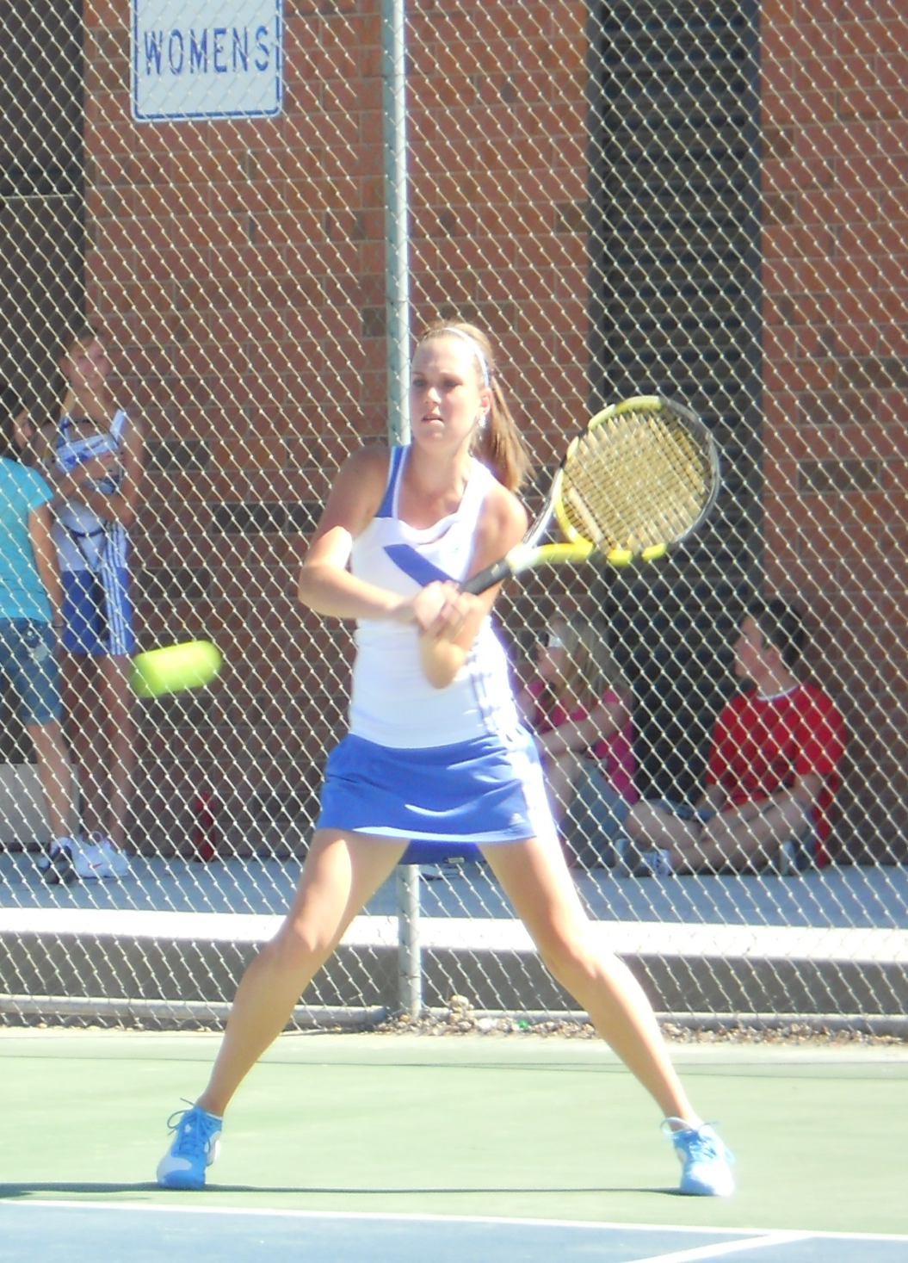
HOBBIES
Tennis
Piano
Singing
Working
Dancing

Slide 4
Childhood
Attended Pre-School and Elementary school
Learned quickly
Played with many friends
Learned wrong from right
Grew close to my sister

Slide 5
ADOLESCENSE
Exceeded in school
Joined athletic teams
Started dating
Got my first car
Made new friends
Grew independent

Slide 6
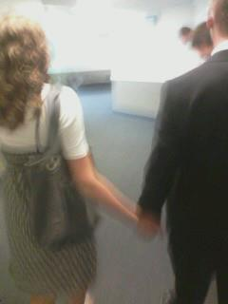
DATING
Dated around
Serious relationship as a junior in high school
Has lasted over three years

Slide 7
MARRIAGE AND KIDS
Planning a marriage for August 2014
No kids
No previous marriage

